Slide 1
What is Java? | Creation | History of Java

Slide 2
What is Java?
Java is a powerful, versatile, and simple general-purpose programming language.
It is one of the most widely used high-level programming languages in the world.
Java is a full-featured general-purpose programming language that is used for developing platform-independent software (applications) running on desktop computers, mobile devices, and servers.
It is a simple, object-oriented, distributed, interpreted, secure, robust, architecture neutral, portable, high performance, multithreaded, and dynamic programming language.
Several commercial Websites are developed by using Java technology on the backend side. The applications for Android cell phones are developed by using Java.

Slide 3
What is Platforms ?
Platform means any hardware or software environment in which a program runs.
Since Java supports a runtime environment, it is called a platform.

Slide 4
Creation of Java
In 1990, Sun Microsystems Inc. (US) imagined a project to develop software for consumer electronic devices that could be controlled by a remote.
Initially, this project was named Stealth Project but later its name was changed to Green Project.
In January of 1991, Bill Joy, James Gosling, Patrick Naughton, Mike Sheridan, and several others met in Aspen, Colorado to discuss this project.
The job of Mike Sheridan was to focus on business development. Patrick Naughton was to work on the graphics system.

Slide 5
Creation of Java
James Gosling was to recognize the proper programming language for the project. He thought that C and C++ programming languages could be used to develop this project.
But the problem he faced in using these languages is that C and C++ were system-dependent programming languages. Due to which they could not be used on various computer systems or electronic devices.
So, he started to develop a new programming language that was completely platform-independent and could be run on any electronic device.
This programming language was initially named Oak but later it was changed to Java in 1995.

Slide 6
Creation of Java
Thus, Java was developed by James Gosling, Patrick Naughton, Chris Warth, Ed Frank, and Mike Sheridan at Sun Microsystems in 1991.
It took 18 months to develop the first working version of Java.

Slide 7
Why named Java?
James Gosling and his team members were consuming a lot of tea while developing the Java programming language.
They felt that they had developed a better programming language because of the good quality tea they had consumed.
Thus, the tea also had its own role in developing Java language. Hence, they kept the name for the language as Java.
Since Java was so unique name, most of the team members preferred to name Java.
Java is an island of Indonesia where the first time coffee was produced, was named java coffee.
Java name was chosen by James Gosling while consuming coffee near his office during the development of java language.
Thus, the symbol for Java is tea cup.
JAVA stands for Just Another Virtual Accelerator. But this is not correct.

Slide 8
Java Impacted the Internet
The Internet played an important role in forwarding Java programming.
Java also solved some of the thorniest issues associated with the Internet: portability and security.
Applets:
At the time of Java creation, the applet was one of the most existing features. An applet is a special kind of small Java program that is designed to be transmitted over the Internet.
It is automatically executed by a Java-compatible web browser.
If a user clicks a link that contains an applet, the applet will automatically download and run in the browser.
In the beginning days of Java, applets were a vital part of Java programming. But over time they became less important.
At last, applet support was completely removed by JDK 11.

Slide 9
Java Impacted the Internet (Conti..)
2. Security:
As we know that when we download a program, we are taking a risk because the code we are downloading might contain a virus, Trojan horse, or other harmful code.
For example, a virus program might collect private information such as credit card numbers, bank account balances, and passwords by searching the contents inside the local file system of computer.
Java technology enables programs to be safely downloaded and executed on the client computer. Java achieved this protection (security) by confining an applet application to the Java execution environment and prevent it from accessing other parts of the computer.

Slide 10
Java Impacted the Internet (Conti..)
3. Portability:
It is a major aspect of the web because there are various different types of computers and operating systems connected to internet.
Java enables to run program virtually any computer connected to the internet and shows the same result. Java made internet portable in nature.

Slide 11
History of Java Version
Several java versions have been released till now.
They are as followJDK Alpha and Beta (1995): The JDK Alpha and Beta was the first release in 1995 but they have highly unstable APIs and ABIs (Application Binary Interface).
JDK 1.1 (19th Feb 1997)
J2SE 1.2 (8th Dec 1998)
J2SE 1.3 (8th May 2000)
J2SE 1.4 (6th Feb 2002)
J2SE 5.0 (30th Sep 2004)

Slide 12
History of Java Version
7. J2SE 5.0 (30th Sep 2004)
8. Java SE 6 (11th Dec 2006)
9. Java SE 7 (28th July 2011)
10. Java SE 8 (18th Mar 2014)
11. Java SE 9 (21st Sep 2017)
12. Java SE 10 (20th Mar 2018)
For further version details, kindly read the Wikipedia link below:
https://en.wikipedia.org/wiki/Java_version_history

Slide 13
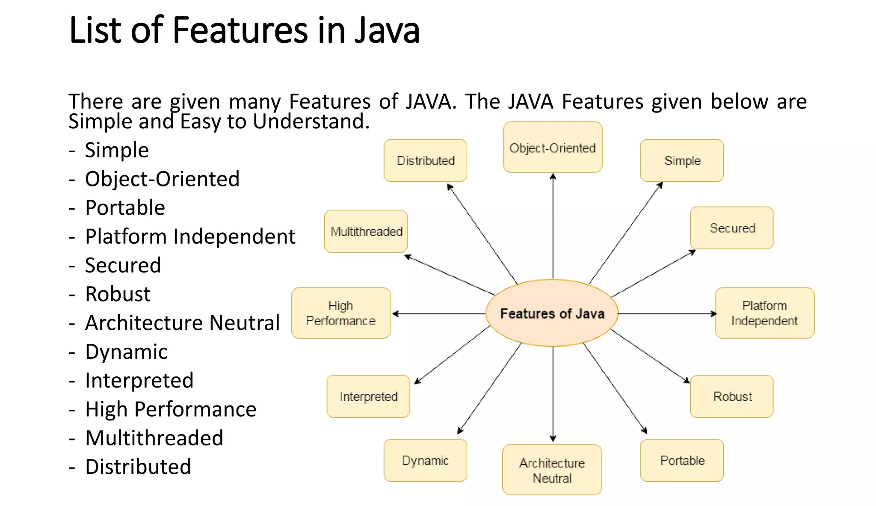
Features of Java Programming Language (Buzzwords)

Slide 14
Features of Java Programming Language (Buzzwords)
1. Simple:
Java is designed as a simple programming language. When Java was developed, the Java team wanted it to be simple for the professional programmer to learn and use effectively.
2. Object-oriented:
Java is a partially object-oriented programming language (OOP). This means that Java program is developed by using classes and objects.
3. Distributed:
Java is designed to support the distributed environment of the Internet because it handles TCP/IP and UDP(User Datagram Protocol) protocols.
Using Java, we can make a program to get information and can distribute it on various computers on a network. Java also supports Remote Method Invocation (RMI) feature that enable a program to distribute methods across a network.

Slide 15
Features of Java Programming Language (Buzzwords)
4. Robust:
The meaning of Robust is “strong”. This means that Java programs are strong because they do not crash easily like C or C++ programs.
Java has an excellent inbuilt feature named exception handling.
Java has a robust memory management feature. Most of the C and C++ programs crash in the middle because of not allocating sufficient space in the memory for a program.
In Java everything is taken care of by JVM only. For example, JVM allots the required memory by a Java program.
Java supports an error checking feature at various stages: Early checking at compile-time and dynamic checking at run time.

Slide 16
Features of Java Programming Language (Buzzwords)
5. Secure:
Since Java supports the distributed environment of the internet, it also provides multiple security features. Security problems like tampering and virus threats can be eliminated or reduced by using Java on Internet.
6. System independence (Architecture neutral):
Java compiler compiles the source code into byte code that is independent of any machine architecture.
The byte code of Java program is not machine-dependent. It can be run on any system machine with any processor and any operating system that implements Java Virtual Machine.
The goal of JavaSoft was to “write once; run anywhere, any time, forever”. To a great extent, JavaSoft accomplished this goal.

Slide 17
Features of Java Programming Language (Buzzwords)
7. Portability:
If a program gives the same result on every system machine, that program is called portable. Java programs are portable.
8. Interpreted:
During compilation, Java compiler converts the source code of the program into byte code. This byte code can be executed on any system machine with the help of Java interpreter in JVM.
If we take any other programming language, only a compiler or an interpreter is used to run programs. But in Java, we use both compiler and interpreter for the execution of the program.

Slide 18
Features of Java Programming Language (Buzzwords)
7. Portability:
If a program gives the same result on every system machine, that program is called portable. Java programs are portable.
8. Interpreted:
During compilation, Java compiler converts the source code of the program into byte code. This byte code can be executed on any system machine with the help of Java interpreter in JVM.
If we take any other programming language, only a compiler or an interpreter is used to run programs. But in Java, we use both compiler and interpreter for the execution of the program.

Slide 19
Features of Java Programming Language (Buzzwords)
9. High Performance:
The speed of interpreter inside JVM to execute a program is slow. To overcome this problem, JavaSoft team has introduced JIT (Just In Time) compiler which improves the performance of interpreting byte code by caching interpretations.
Due to which the speed of execution of java program is enhanced. So, both interpreter and JIT compiler in JVM work together to run the program.
10. Multithreaded:
Java supports multi-threading programming that allows to write programs to do several works simultaneously. A thread is an individual process to execute a group of statements. JVM utilizes multiple threads to execute different blocks of code.
11. Dynamic:
Before the development of Java, only static text was displayed in the browser. But using applet program, we can also create animation dynamically on the Internet.

Slide 20
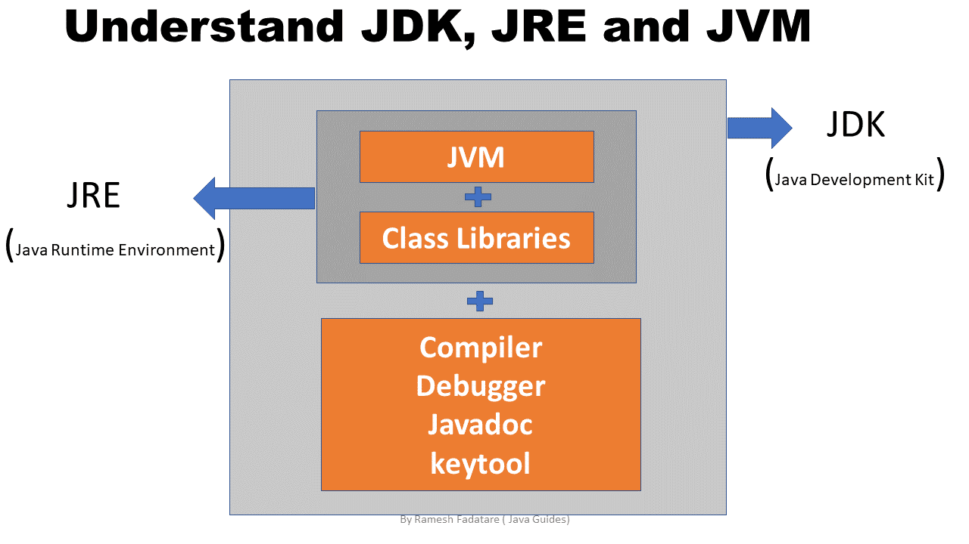
Java Development Kit (JDK)

Slide 21
Java Development Kit (JDK)
Java Development Kit (JDK) is a software development environment that is developed and distributed by Oracle.
It is used for building (developing) java software applications and applets.
It is used to write java programs by programmers.
JDK is a platform-specific software and that’s why we have separate installers for Windows, Mac, and Unix systems.

Slide 22
Different Components of Java Development Kit.
Java Development Kit has the following components.
Java Runtime Environment (JRE)
Java Language Specification
Java Development Tools

Slide 23
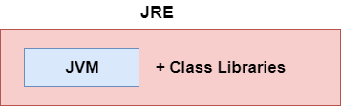
JRE(Java Runtime Environment)
It is an environment that is required for running (executing) a java application.
It cannot be used for the development of Java applications.
It is used only for executing the application program.
Java Runtime Environment is a collection of programs that contain JVM (Java Virtual Machine), Java APIs (Application Programming Interface), and Java Class Libraries that help in the development of Java application programs.

Slide 24
Java Language Specification
The Java language specification is a technical definition of syntax and semantics of the Java programming language.
Find the complete Java language specification at
https://docs.oracle.com/javase/specs/

Slide 25
Java Development Tools
It consists of Java compiler, JAR tool, class file disassembler, debugger, JRE builder, etc. Java Development Tools provides everything for compiling, running, monitoring, debugging, and documenting applications.
The most important tools are javac compiler, java launcher, and javadoc documentation tool.
When we compile a C or C++ program, the program code is directly translated into machine code of a particular processor or a particular platform.
But, Java program run with two parts of JDK. The two most important parts of JDK are:
1.) Java compiler (javac) and
2.) An interpreter.

Slide 26
What is Java Compiler?
Java compiler is a program that is implemented in C and C++ with the name javac.exe.
javac is short for java compiler.
It is platform-independent.
It is responsible for the following tasks that are as follows:
Java compiler checks the Syntax error.
It converts source code into byte code with the help of Java Virtual Machine (JVM). Bytecode is just like machine code, but it is not for a specific processor or platform. It cannot be directly executed.
Java compiler also adds the additional code to your program if required.

Slide 27
What is Java Interpreter ?
Java interpreter is a program that is implemented in C and C++ with the name java.exe.
It is platform-dependent.
It is responsible for the following tasks.
a) Java interpreter converts the byte code into the native code line by line.
b) It executes the program on your system.

Slide 28
Editions of Java Platforms
The Java platform comes in three editions based upon device type. They are as follows:
1. Java SE (Standard Edition): This edition is used to develop client-side applications. It is used to develop applications for desktop, communication, and user interface.
2. Java EE (Enterprise Edition): This edition is used to develop server- side applications such as Java servlets, Java Server Pages (JSP), and Java Server Faces (JSF).
In other words, it is used to develop web-based, messaging, distributed, and enterprise applications.

Slide 29
Editions of Java Platforms (Cont..)
3. Java ME (Micro Edition): This edition is used to develop applications for mobile devices, such as cell phones. It is also used to develop Personnel Digital Assistants, Setup Box, and printers applications.
Java SE is the foundation upon which all other Java technology is based. There are many versions of Java SE but you download the latest and stable Java SE edition.

Slide 30
Bytecode in Java | Bytecode vs Machine code

Slide 31
Bytecode in Java
A bytecode is a binary program code that can only run on JVM.
In other words, it is a machine language (code) for JVM in the form of .class file, but it is not machine specific because it is not a native code.
It is not machine language (machine instructions) for any specific hardware processor.
Byte code acts as an intermediate language that is platform (machine) independent.
It is generated by Java interpreter that can be directly run by a real machine.

Slide 32
Characteristics of Java Bytecode
Java bytecode has two most important characteristics that are as follows:
Byte code is independent of processor, i.e., Java program can be executed on any processor architecture.
It does not depend on operating systems such as Windows, Linux, and Mac OS.

Slide 33
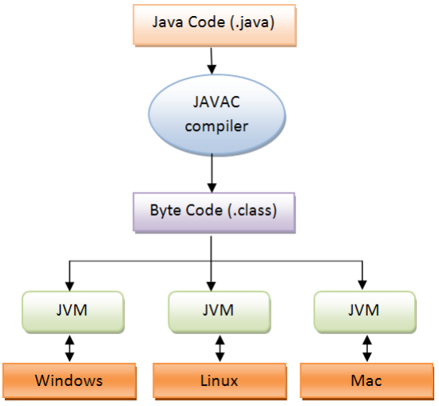
How does Bytecode work in Java?

Slide 34
Key points to remember:
1. A bytecode in Java is a set of byte-long instructions that Java compiler produces and Java interpreter (JVM) executes.
2. When Java compiler compiles .java file, it generates a series of bytecode (machine independent code)and stores them in a .class file.
3. JVM then interprets and executes the byte code stored in the .class file and converts them into machine code.
4. The byte code remains the same on different platforms such as Windows, Linux, and Mac OS.

Slide 35
What is JRE | Java API | Class Loader

Slide 36
Java Runtime Engine (JRE)
JRE is a software environment that is required for executing Java applications on any system regardless of operating system and underlying hardware.
JRE is a part of the Java Development Kit but cannot be used independently to execute any bytecode (compiled java program).
Java Runtime Environment is a collection of programs that contains Java Virtual Machine and many class libraries files that are required to run programs on JVM (via java command).
Java Development Kit also contains Java Runtime Environment (JRE) that enables to run Java program in Eclipse of your system.

Slide 37
Components of Java Runtime Environment (JRE)
JRE consists of the following main components that are as follows:
Java API (Application Programming Interface)
Class Loader
Bytecode verifier
Java Virtual Machine (Interpreter)

Slide 38
What is Java API (Application Interface Programming)?
Java Application Programming Interface (API) is a very large collection of prepackaged, ready-made software components that provides the core functionality of the Java programming language.
Java API is a large collection of already defined classes, interfaces, and methods in the form of Java packages.
It provides many useful capabilities, such as Graphical User Interface (GUI), Date, Time, and Calendar capabilities to programmers.
Some popular libraries and their functionality from the Java API:
a) java.lang
b) java.util
c) java.io
d) java.math

Slide 39
Complete List of Java API (Application Interface Programming)
A complete list of all classes in Java API can be found at Oracle’s website:
https://docs.oracle.com/javase/7/docs/api/

Slide 40
What is Class Loader in Java?
When we write a program in java, the program is placed in memory by the class loader before it can be executed.
Java Class loader takes .class file containing bytecode and transfers it to the memory. It loads the .class file from a disk on your system or over a network.
After loading of class, it is passed to the bytecode verifier.
There are basically three subcomponents of Class loader in Java. They are as follows:
1) Bootstrap class loader
2) Extensions class loader
3) System class loader

Slide 41
What is Bytecode Verifier?
The bytecode verifier verifies that byte codes are valid or not without breaching any of Java’s security rules.
It gives special attention to checking the type of all the variables and expressions in the code.
Bytecode verifier ensures that there is no unauthorized access to memory.
Once the code is successfully verified, it is transferred to Java Virtual Machine (JVM) for interpretation.

Slide 42
What is JVM | JVM Architecture | JIT Compiler

Slide 43
Java Virtual Machine (JVM)
Java Virtual Machine (JVM) in Java is the heart of the entire execution process of the Java program.
It is basically a program that provides the runtime environment necessary for Java programs to execute.
In other words, Java Virtual Machine (JVM) is an abstract computer machine that is responsible for executing Java bytecode (a highly optimized set of instructions) on a particular hardware platform.
It is also called Java run-time system.

Slide 44
Java Virtual Machine (JVM)
JVM implementation is known as Java Runtime Environment (JRE).
Since JVM is platform-dependent, therefore, it is available for many hardware and software platforms.
The most popular JVM is HotSpot that is produced by Oracle. It is available for many operating systems such as Windows, Linux, Solaris, and Mac OS.
We cannot run the Java program unless JVM is available for the appropriate hardware and operating system platform.

Slide 45
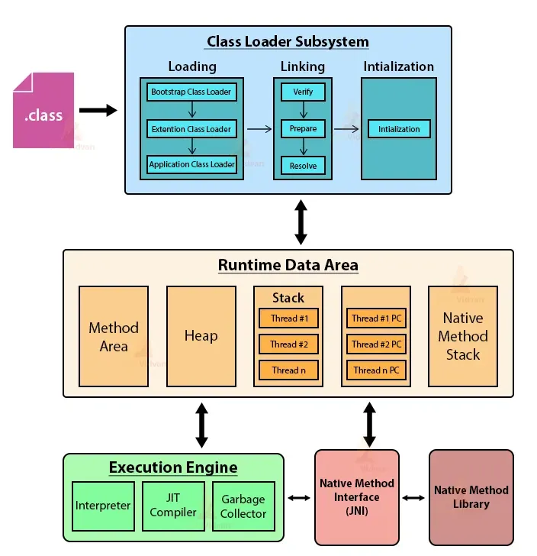
Internal Structure of JVM

Slide 46
What is JIT Compiler in Java?
JIT compiler in Java is the part of JVM that is used to increase the speed of execution of a Java program.
In other words, it is used to improve the performance of the execution of the program.
It helps to reduce the amount of time needed for the execution of the program.
When .class file is loaded in the memory, JVM, first of all, tries to identify which code is to be given to the interpreter and which one to JIT compiler so that the performance is better.
The blocks of code given to the JIT compiler are also called hotspots in Java. T
his feature in Java language really improves the execution time of the program at runtime, especially when it is to be executed multiple times.

Slide 47
What is Java Compiler? | How works it?

Slide 48
Key points to remember about Java Compiler
Compiler is a translator program that converts high-level language programs (source code) into the machine language code called object code.
We can execute the generated object code at any time.
The object code refers to a code that can be executed to generate the output of the program written in the high-level language even without the availability of source code (i.e. actual program).
During the compilation process, Java compiler converts the complete program into an object code that is a machine readable and notifies the user about all the errors in the program.

Slide 49
Key points to remember about Java Compiler
Compliers are language specific. That is, each high-level language has its own compiler program. Hence, we cannot use a C++ compiler to compile a source code written in Java.
A compiler does not detect logical errors in the program.
It only creates an object code and does not execute the program.

Slide 50
Interpreter in Java | Interpreter vs Compiler
Interpreter in Java is a computer program (software) that implements Java Virtual Machine (JVM) and runs Java applications (programs).
It translates (converts) bytecode to machine code (native code) line by line during runtime.
In other words, Java interpreter is a computer program that converts the high-level program into assembly language (machine language).
It is used for executing Java programs. Interpreter takes bytecode as an input and executes that code by converting it to machine code. It is recognized by “Java.exe” command.

Slide 51
Kindly read the JVM internal architecture in details:
https://ssudan16.medium.com/internals-of-jvm-architecture-a7162e989553

